Slide 1

File Indexing System
By Ankit Gautam

Slide 2

Introduction
File Indexing Engine is an application built to index and visualize the contents of the files kept in user entered directories. The indexes are created and stored in a destination directory provided by the user. These indexes can be searched and sorted on various parameters like file name, file size, number of lines, number of words. Also, tokens are extracted and displayed to the user on the user interface.
There are two major components of the File Indexing Engine:
User Interface, built using Thymeleaf and Spring Boot.
Indexing Engine, built using Java.

Slide 3

Features of Application
Continuously watch the multiple directories provided by the user for any changes like creation or addition of new file(s) or directory(s), modification in any existing file’s content and deletion of file(s) or directory(s) by the user.
Using Externalisation and Serialization to store Statistics of Files and Frequency of all Keywords of Files. For Each Directory make a HashMap with key as File Path and Value as Serialized Object.
Store the generated HashMap in a file named “output.txt” in user entered directory.
Read the tokens from each file being watched while simultaneously .
Search keyword feature to search for tokens

Slide 4
Features of Application
Search Query feature supports searching the token in currently present files and store it in Searched_Keyword.txt.
Sort Files on: Filenames Number of Lines Number of Words Size
And Store it in Sorted_File_Details.txt.
Generate Token as well its frequency in every files in directory.

Slide 5
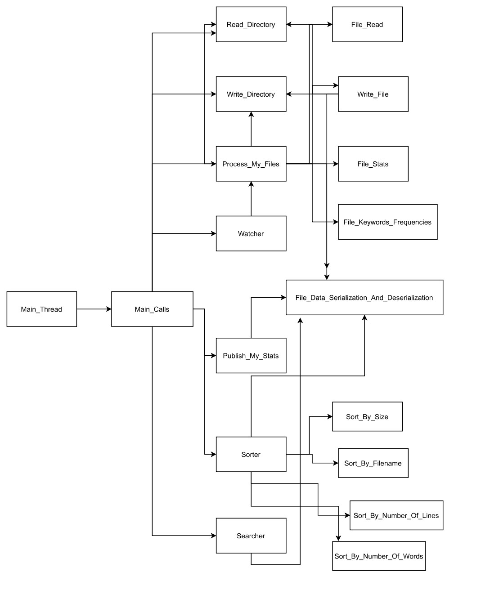
Workflow

Slide 6
Conclusion
File Indexing Engine is an application built to index and catalogue our files data such as the number words, number of lines, size of file along with other metadata in them. When we search after indexing it looks at an index of terms to find results faster.
Also, along with indexing, we monitor the provided directories for any changes at the file level or the directory level.’
Indexing is done for performance reasons as indexing files does impact performance. If you have a few folders that you routinely access and search for files in, you can greatly reduce the time it takes to find these files in Windows Search by indexing them

